Slide 1
Weather Drone

Slide 2
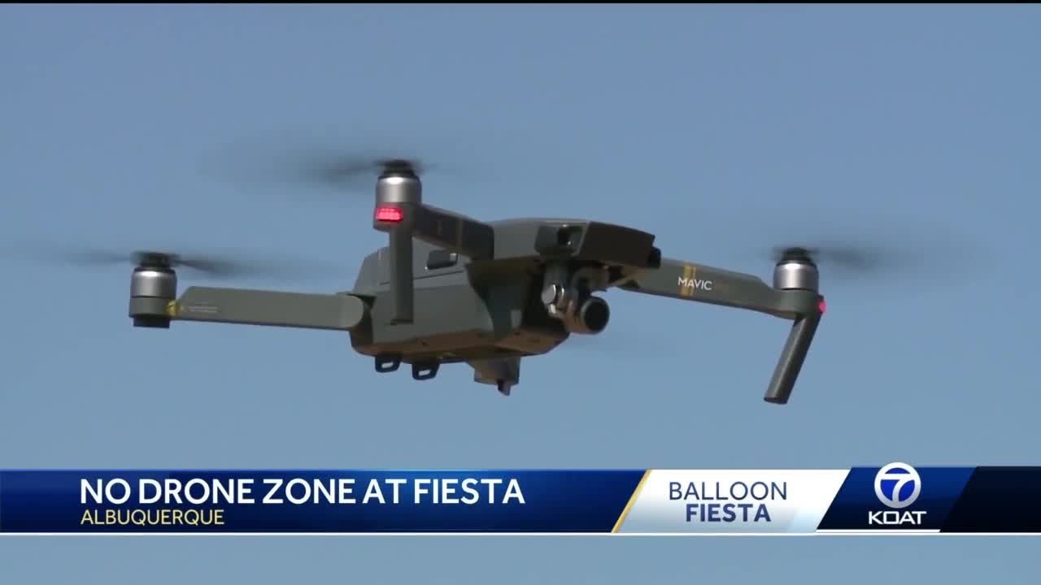
Albuquerque 2019
Introduction of weather drone
Wind speed and direction at 100 foot increments
$34,000 according to weather guys at mini safety seminar

Slide 3
Albuquerque 2019
I asked if it was possible with a mass market for the price would come down so individual balloonists could afford one
They were very skeptical

Slide 4
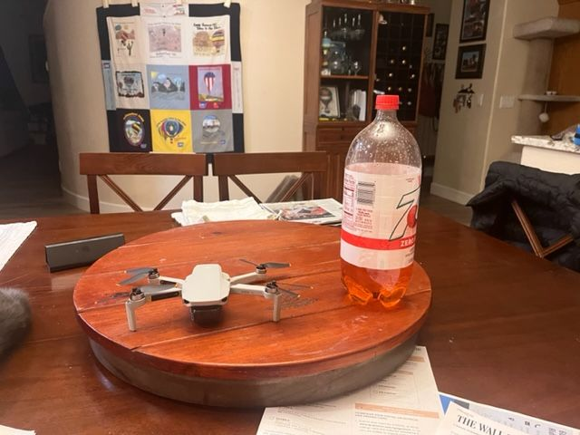
Two Years Later
DJI Mini SE
$300
$3 per month subscription for software

Slide 5
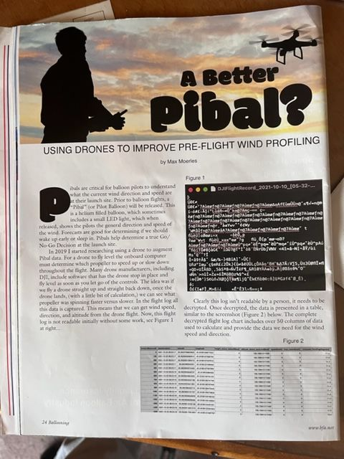
Ballooning Magazine
Nov/Dec 1021
Max Moerles - Florida
Article includes a number of URLs
Including a really good Power Point
URL’s will be on the website
Black area is an example of electronic gibberish – hoping we can decrypt

Slide 6
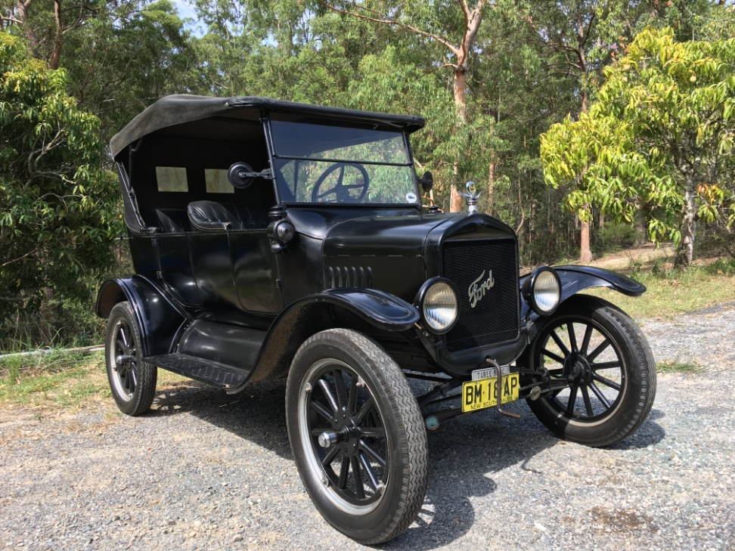
$300
How Can DJI Sell So Cheap?
A page out of Henry Ford’s book
  Low price – high volume
  $600 in 1913
  $260 in 1925
  Assembly line
  No frills

Slide 7
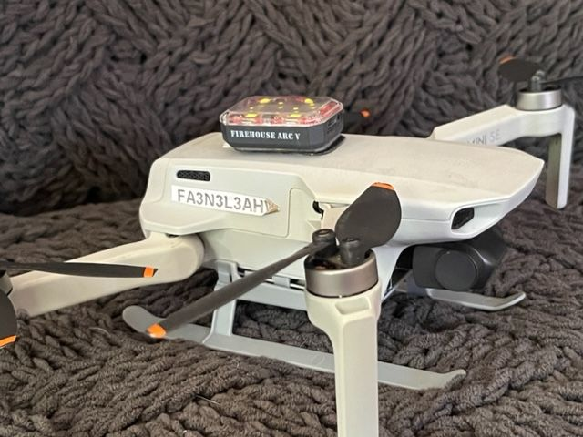
How Can DJI Sell So Cheap?
DJI targeted recreational user
  Cost - $300 is Christmas gift
    Controller screen is iPhone
    Six KM range
    30 minute battery life
  249 grams - .55 pounds
    No computer chip
    Warning light - $30
    Skids - $18

Slide 8
Demonstration

Slide 9
Boatload of DJI Videos
https://www.youtube.com/watch?v=Wzxg84iSbnE

Slide 10
Boatload of DJI Videos
Google:
DJI Mini SE Video

Slide 11
Winnemucca
5/15/22
Time | Altitude | Distance | Direction | Speed
00 min 15 sec | 43.0 ft | 5 ft | 84 deg | 13.53 mph
00 min 20 sec | 70.5 ft | 4 ft | 81 deg | 15.84 mph
00 min 25 sec | 101.07 ft | 5 ft | 72 deg | 16.98 mph
00 min 30 sec | 102.4 ft | 4 ft | 83 deg | 14.45 mph
00 min 35 sec | 134.5 ft | 4 ft | 70 deg | 17.34 mph
00 min 40 sec | 152.9 ft | 5 ft | 61 deg | 19.01 mph
00 min 45 sec | 163.7 ft | 4 ft | 52 deg | 19.22 mph
00 min 50 sec | 195.5 ft | 4 ft | 52 deg | 19.95 mph
00 min 55 sec | 203.4 ft | 5 ft | 43 deg | 22.79 mph

Slide 12
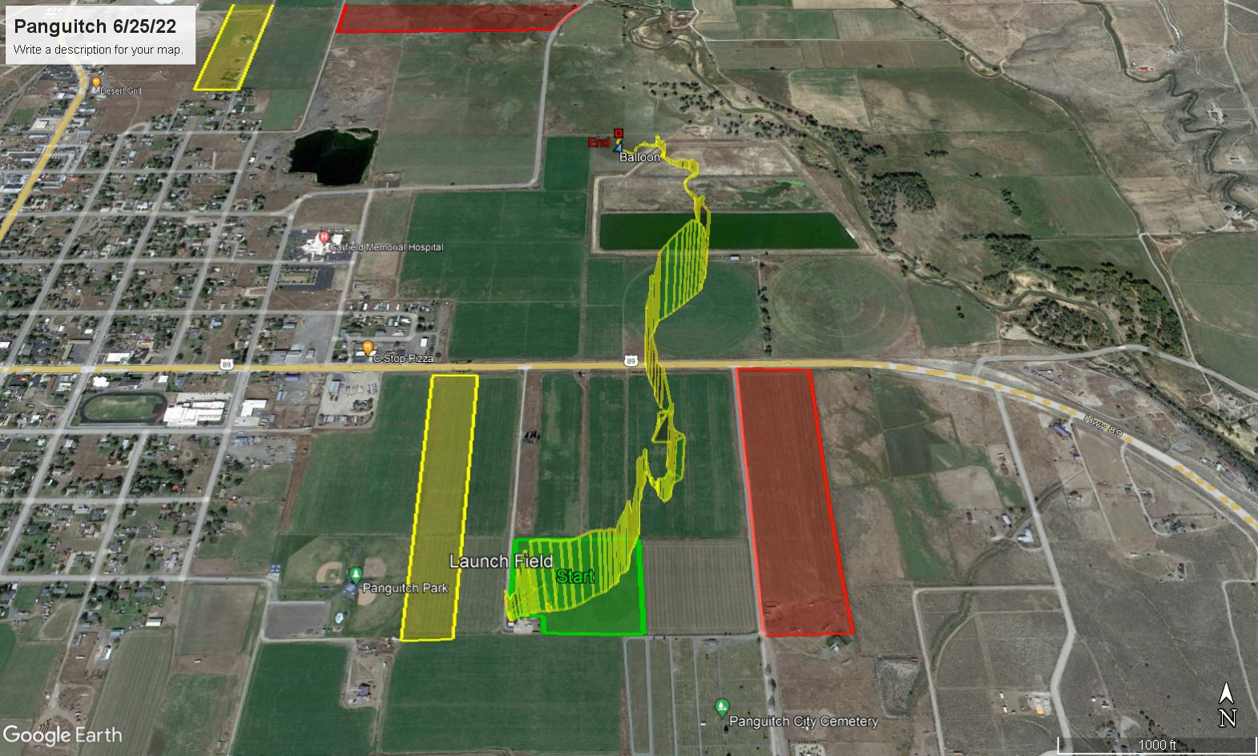
Panguitch 6/25/22

Slide 13
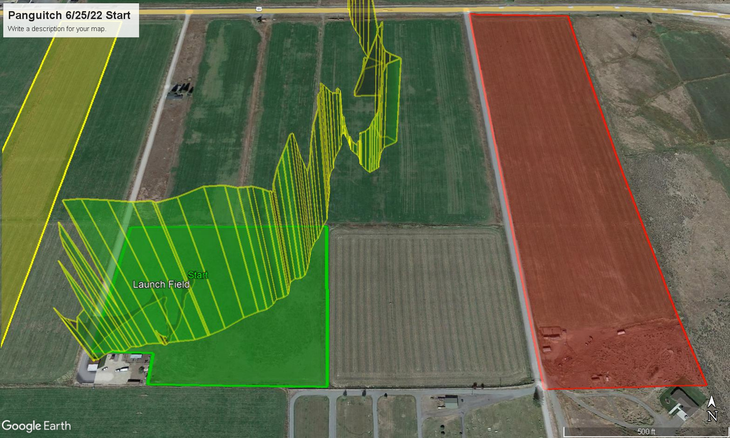
High
Altitude | Direction | Speed
253.3 ft | 144 deg | 2.64 mph
252.9 ft | 157 deg | 2.66 mph
272.3 ft | 158 deg | 1.90 mph
301.5 ft | 169 deg | 1.54 mph
302.2 ft | 167 deg | 1.34 mph
333.3 ft | 195 deg | 0.58 mph
352.7 ft | 217 deg | 0.65 mph
351.7 ft | 188 deg | 0.45 mph

Slide 14
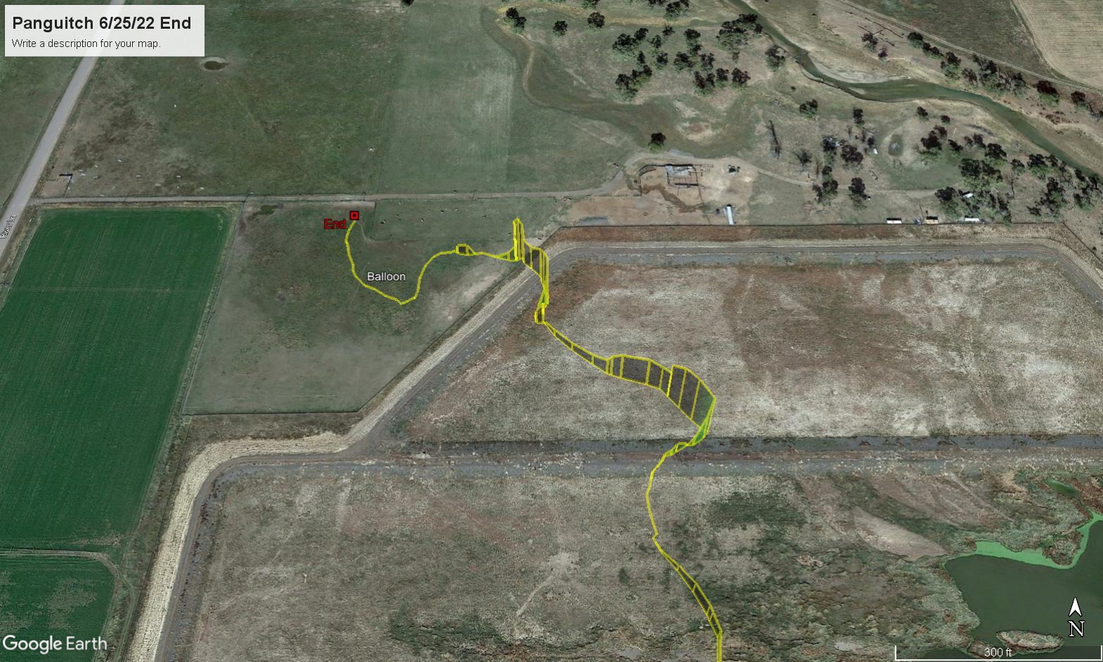
Low
Altitude | Direction | Speed
20.3 ft | 202 deg | .74 mph
44.0 ft | 199 deg | 1.23 mph
47.6 ft | 185 deg | 2.19 mph
122.4 ft | 159 deg | 5.19 mph
154.2 ft | 159 deg | 4.14 mph
154.5 ft | 160 deg | 4.21 mph
154.2 ft | 159 deg | 3.94 mph
165.0 ft | 159 deg | 4.38 mph

Slide 15
Intermediate
Altitude | Direction | Speed
169.8 ft | 146 deg | 3.85 mph
206.7 ft | 140 deg | 4.00 mph
228.0 ft | 137 deg | 3.87 mph

Slide 16
  What Are The Rules To Fly A Drone?
Exception for Limited Recreational Operations of Unmanned Aircraft
No need to comply with FAR Part 107

Slide 17
  What Are The Rules To Fly A Drone
Only Recreational flights
Under 250 grams - .55 pounds
No need to register aircraft

Slide 18
How To Register a Drone
https://www.faa.gov/uas/getting_started/register_drone

Slide 19
Couple More Things
Airspace
License
Waivers
Display
Other stuff

Slide 20
FAR Part 107 - Airspace
400 feet in uncontrolled airspace
https://faa.maps.arcgis.com/apps/webappviewer/index.html?id=9c2e4406710048e19806ebf6a06754ad

Slide 21
FAR Part 107 – Drone License
Usual stuff
  16 or older
  Read and write English
Knowledge test
  60 questions
  43 if have another pilot certificate
Online oral exam - $100
  Re-up every 24 months

Slide 22
Waivers
Waiver to go higher than 400 feet
  Google Part 107 Waiver
  107.31 Visual Line of Sight
  107.51(b) 400 foot maximum

Slide 23
Display – Measuring With A Rubber Ruler
Tonopah 9/29/22
Winnemucca 5/25/22

Slide 24
Other Stuff I’ve Been Thinking About
How fast do pibals go up
Rocks suck
Wait till the sun comes up
Measuring rotors
Predict Tonopah from RUC forecast

Slide 25
Parting Advise
1 – Look at the videos
  Especially the one attached to the Ballooning Magazine article by Max Moerles
2 – Read some of the stuff the FAA puts out
  DroneZone.com
3 - Google AirData.com about wind direction and speed software
4 – Jump in

Slide 26
Questions
Or
Comments

