Slide 1
Making Red Zone Maps – Part 1
There are probably a dozen ways to make a map with Google Earth
I know one
And I learned that through trial and error
So if anyone has any better ideas I’m all ears

Slide 2
Have Only Needed Four Shapes
Straight lines
Crooked lines
Areas
Circles

Slide 3
Seven Sections
1 – Open Google Earth
2 – Set Up Folder
3 – Straight Lines
4 – Crooked Lines
5 – Areas
6 – Circles
7 – Getting File Into Hot Air App
8 – Sky Harbor Airspace

Slide 4
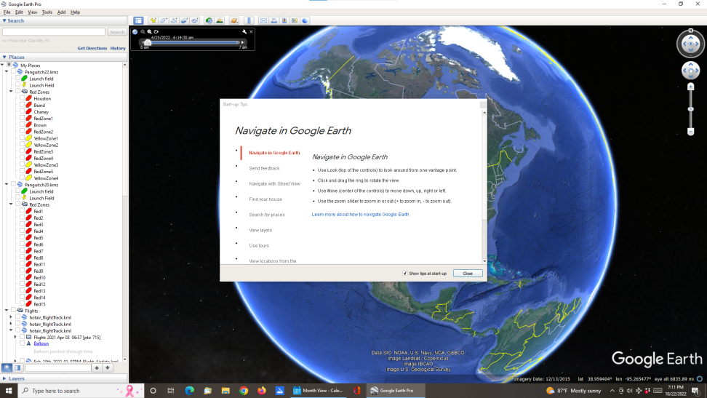
1 – Open Google Earth

Slide 5
Open Google Earth
Click on Close button

Slide 6
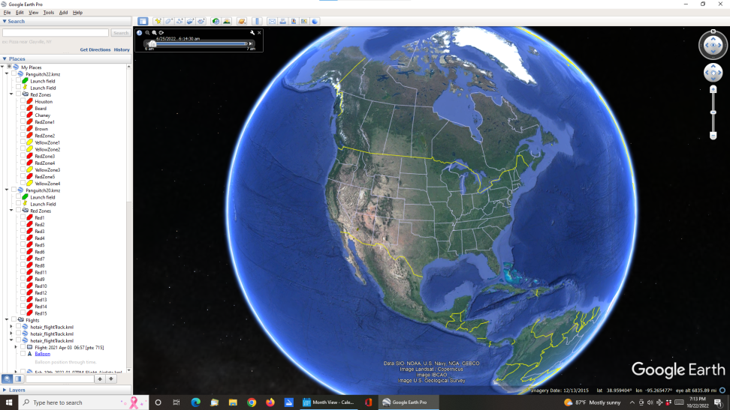
Open Google Earth
Files on the left hand side are my other maps

Slide 7
Open Google Earth
Files on the left hand side are my other maps
Two ways to scroll to area you want
  Plus and minus keys on upper right

Slide 8
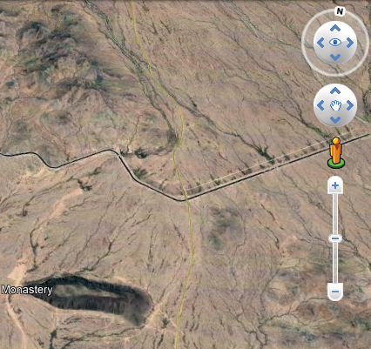
Open Google Earth
Files on the left hand side are my other maps
Two ways to scroll to area you want
  Plus and minus keys on upper right

Slide 9
Open Google Earth
Files on the left hand side are my other maps
Two ways to scroll to area you want
  Plus and minus keys on upper right
  Wheel on mouse

Slide 10
Open Google Earth
Files on the left hand side are my other maps
Two ways to scroll to area you want
  Plus and minus keys on upper right
  Wheel on mouse
Will continually need to center area of interest by right clicking and dragging

Slide 11
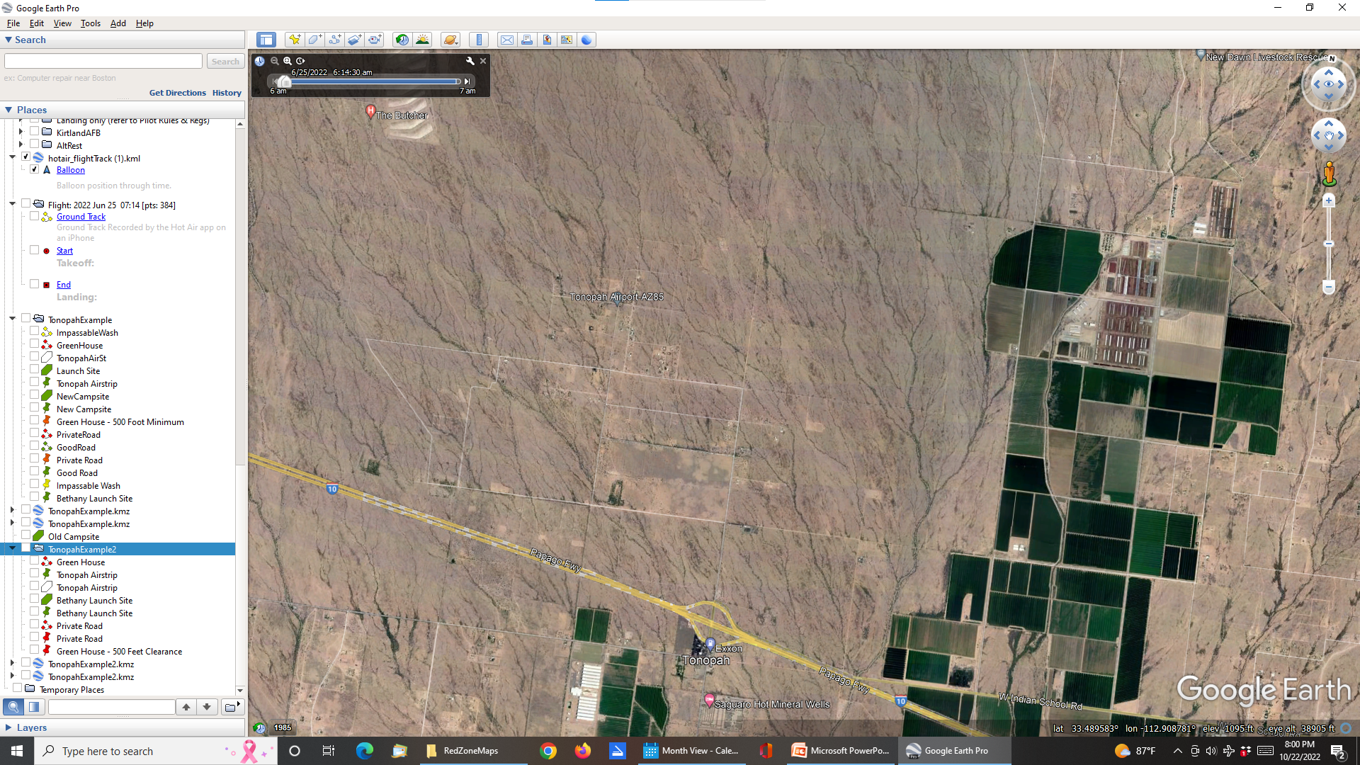
Tonopah - Where We Fly

Slide 12
2 – Set Up Folder

Slide 13
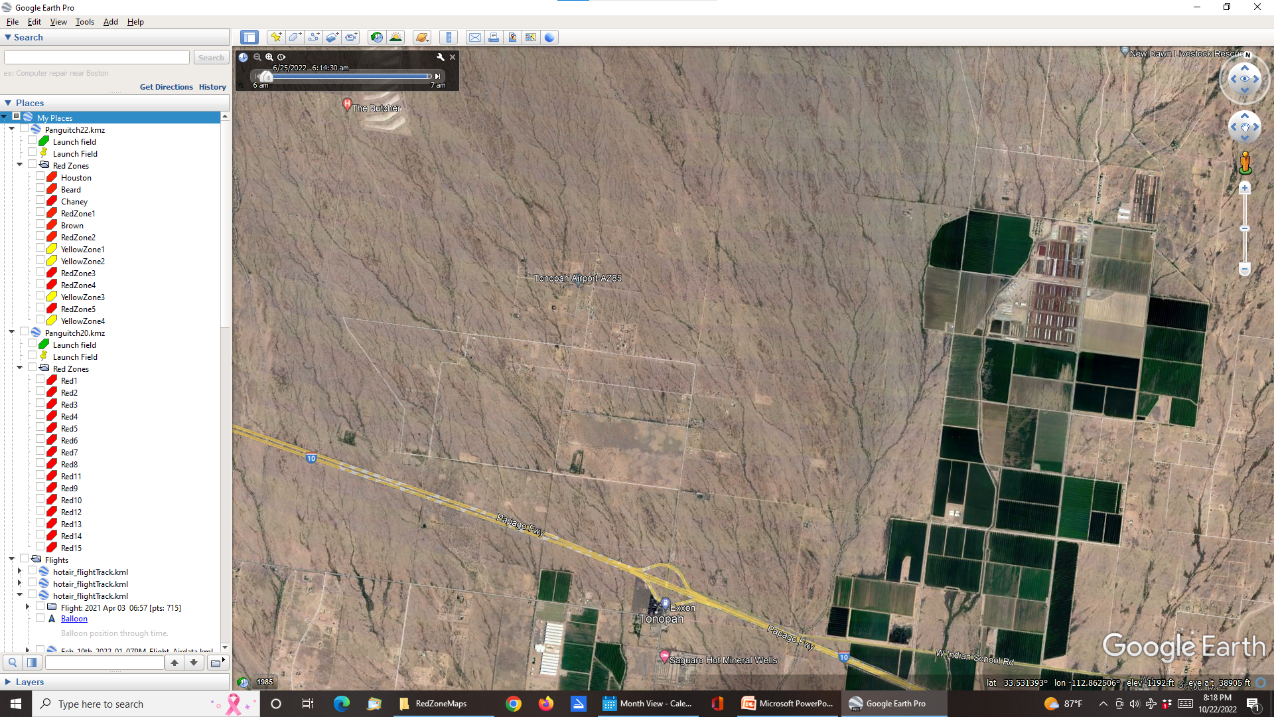
Set Up Folder
Right click on My Places in way upper left

Slide 14
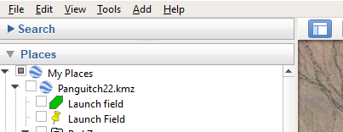
Set Up Folder

Slide 15
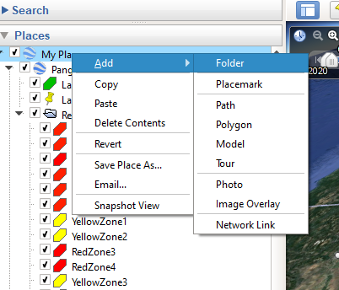
Set Up Folder
Right click on My Places in way upper left
Then click Add

Slide 16
Set Up Folder
Right click on My Places in way upper left
Then click Add
Then click Folder

Slide 17
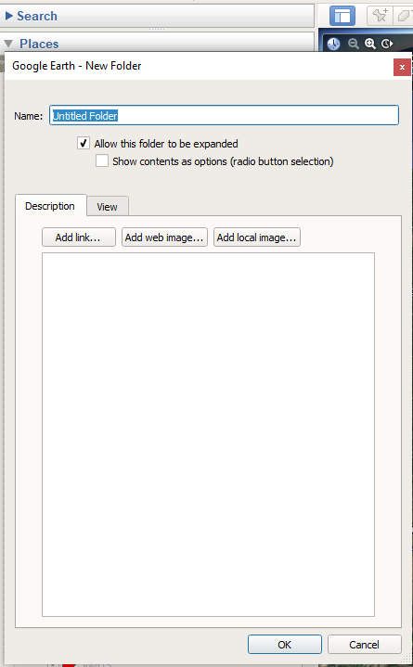
Set Up Folder
Right click on My Places in way upper left
Then click Add
Then click Folder
Label folder

Slide 18
Set Up Folder
Right click on My Places in way upper left
Then click Add
Then click Folder
Label folder
  My folder will be named Tonopah 3
  Click OK

Slide 19
Set Up Folder
Will need to have this folder selected when adding lines and shapes to map

Slide 20
3 – Add Straight Line

Slide 21
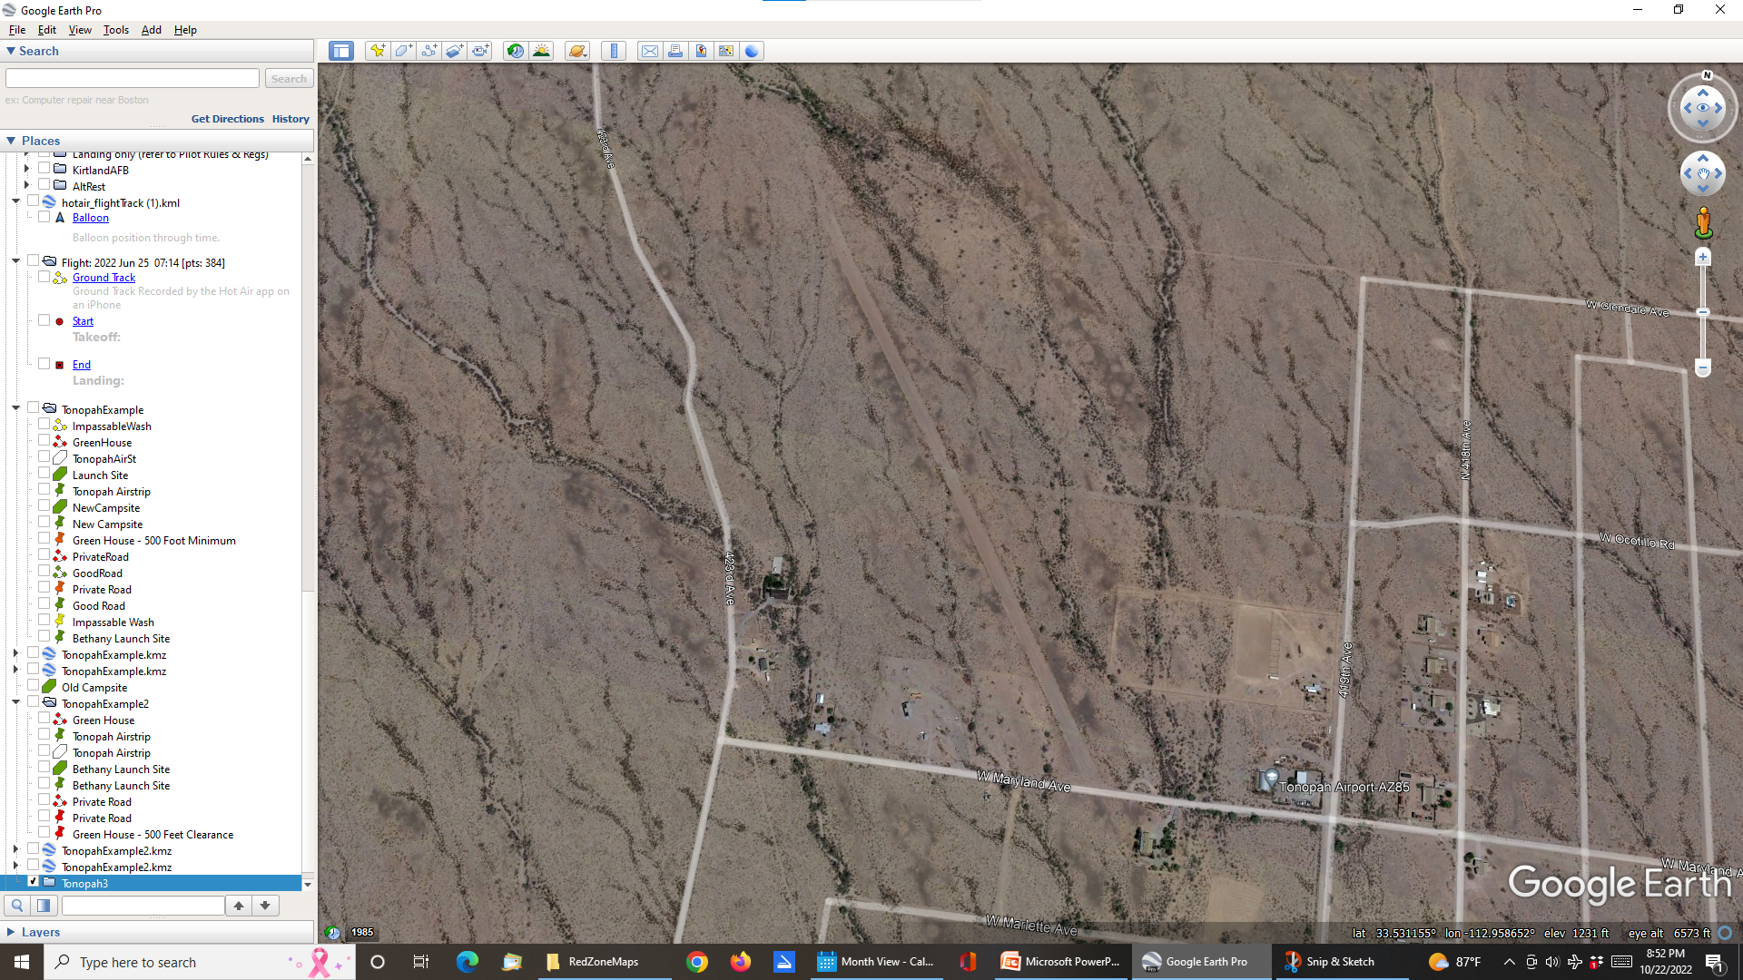
Add Straight Line
Select folder
  Tonopah 3

Slide 22
Add Straight Line
Select folder
  Tonopah 3

Slide 23
Add Straight Line
Select folder
  Tonopah 3
Right click on Add Path icon
  Fourth from the left

Slide 24
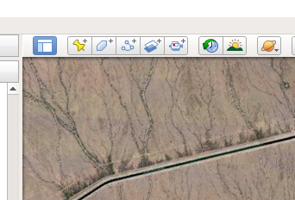
Add Straight Line

Slide 25
Add Straight Line
Select folder
  Tonopah 3
Right click on Add Path icon
  Fourth from the left
Unclick

Slide 26
Add Straight Line
Select folder
  Tonopah 3
Right click on Add Path icon
  Fourth from the left
Unclick
Will get square for curser

Slide 27
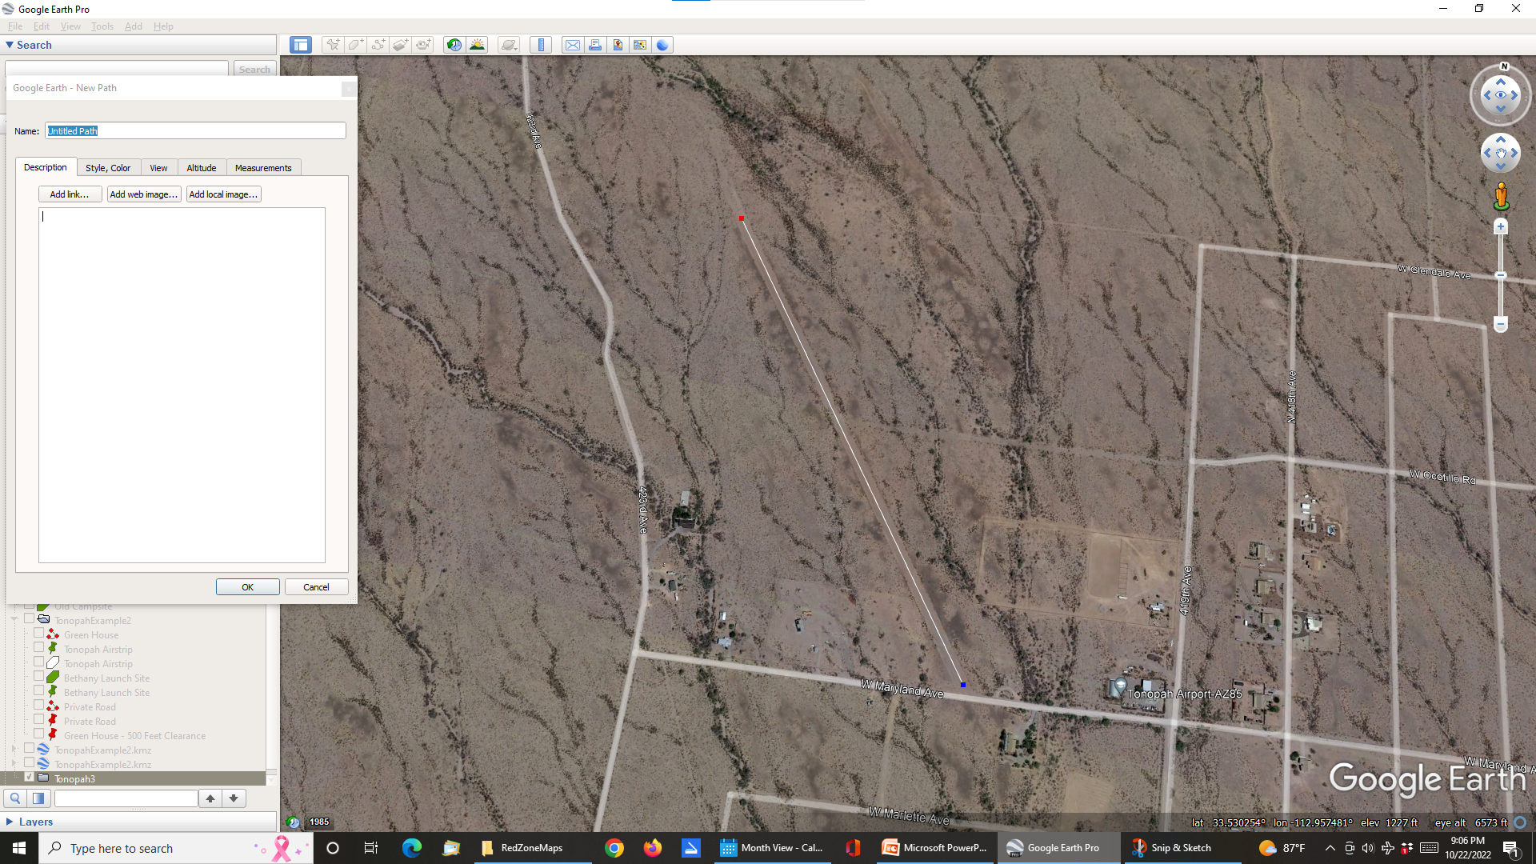
Add Straight Line
Click at start of line
  Tonopah airstrip

Slide 28
Add Straight Line
Click at start of line
  Tonopah airstrip
Click at end of line

Slide 29
Add Straight Line
Click at start of line
  Tonopah airstrip
Click at end of line
Add label in Name window
  I used Tonopah Airstrip

Slide 30
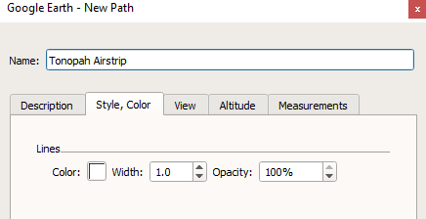
Add Straight Line
Click on Style, Color tab

Slide 31
Add Straight Line
Click on Style, Color tab
And then on Color

Slide 32
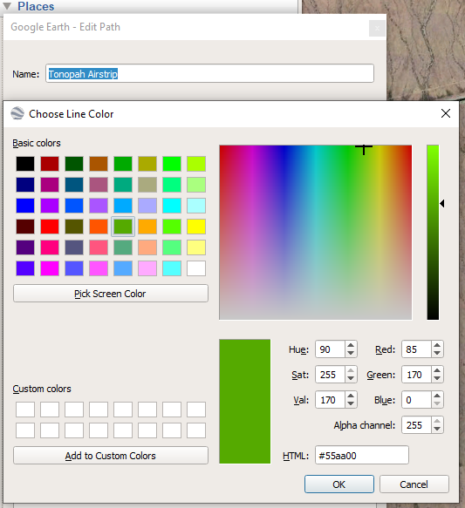
Add Straight Line
I selected green because we can launch and land on airstrip

Slide 33
Add Straight Line
I selected green because we can launch and land on airstrip
Then click on OK to exit from the Choose Line Color window

Slide 34
Add Straight Line
Then click on Width
  I keyed in 5.0
Then click OK at bottom of window

Slide 35
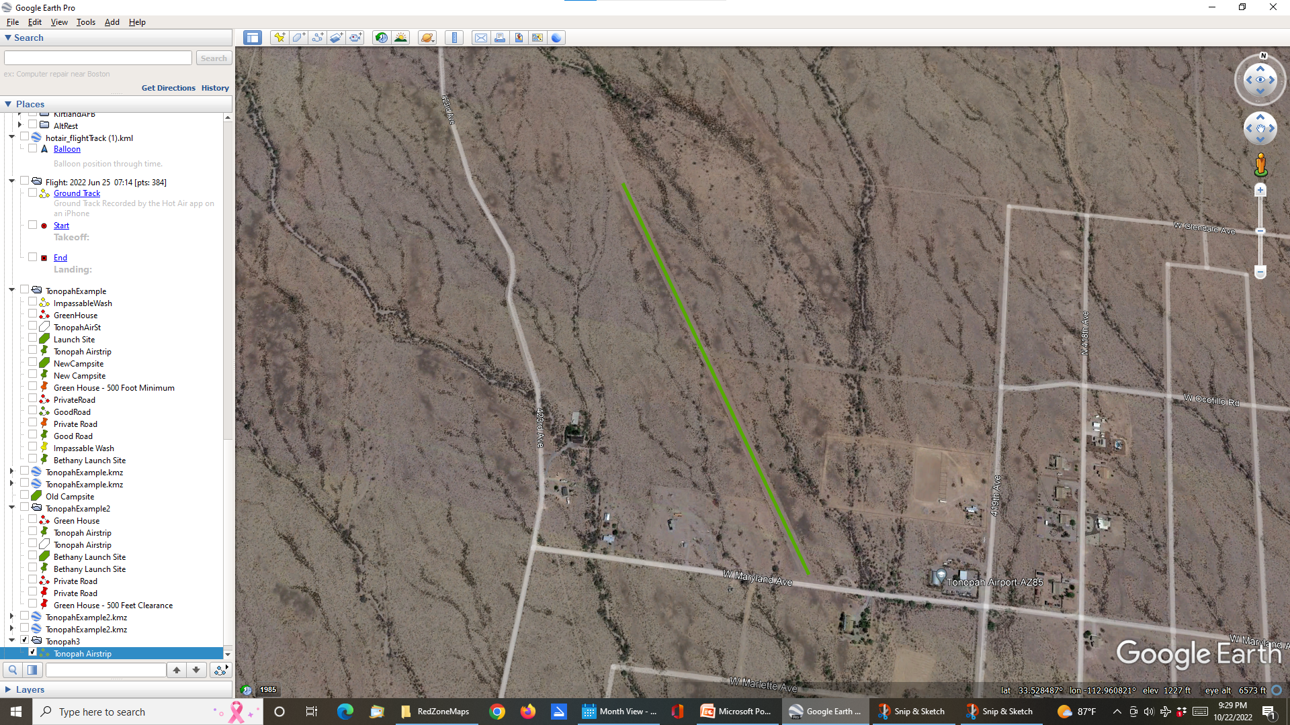
Add Straight Line
Done

Slide 36
Add Straight Line
Done
Notice how Tonopah Airstrip is in the Tonopah 3 folder

Slide 37
Add Straight Line
Done
Notice how Tonopah Airstrip in under the Tonopah 3 folder
Many times I have gotten confused and the shape ends up in some other folder
Easy to drag and drop in back to Tonopah 3

Slide 38
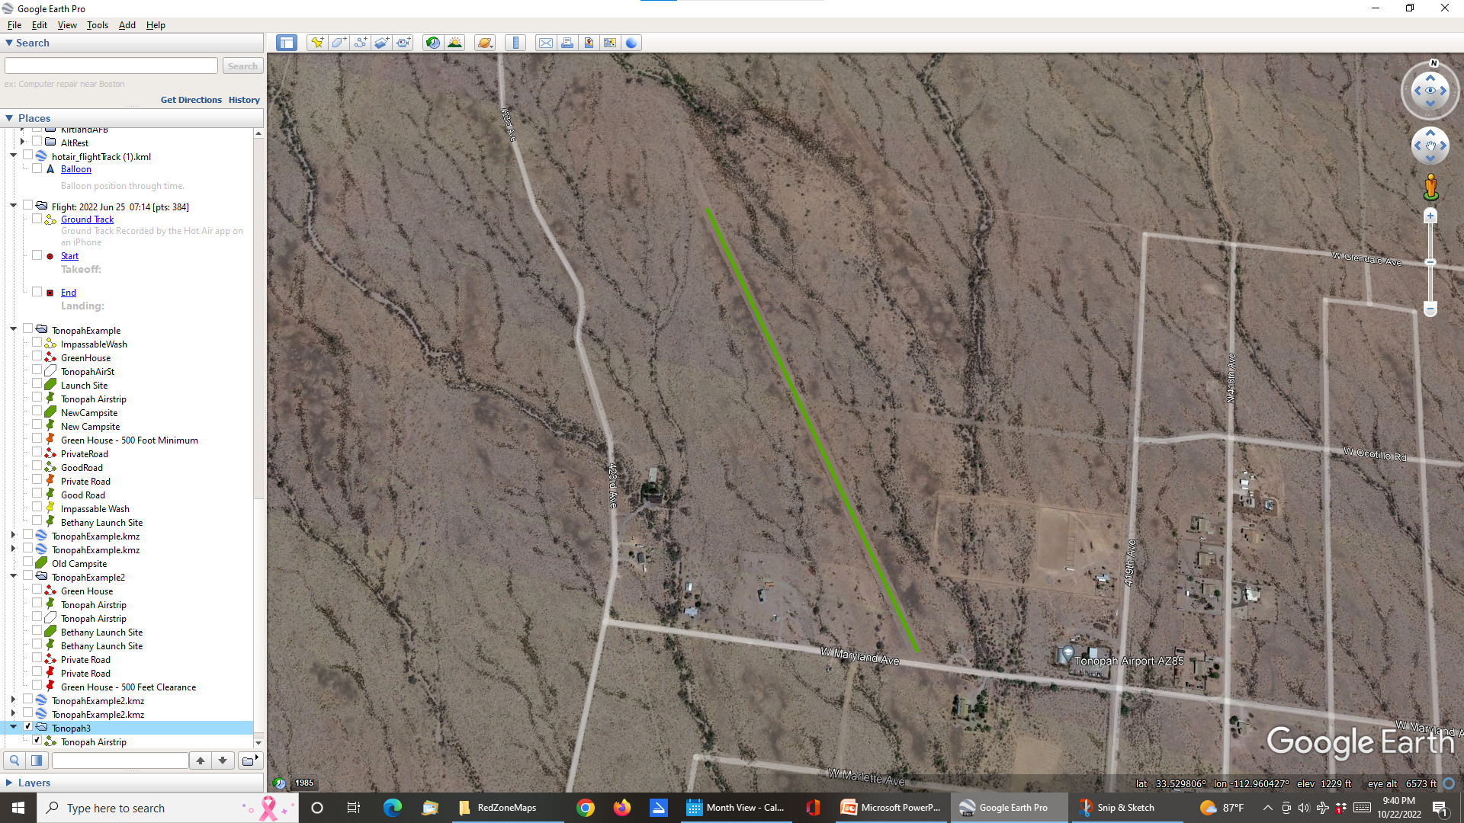
Add Label

Slide 39
Add Label
Select Tonopah 3

Slide 40
Add Label
Select Tonopah 3
  Being in the right folder is really important

Slide 41
Add Label
Select Tonopah 3
  Being in the right folder is really important
Click on yellow push pin at upper left

Slide 42
Add Label
Select Tonopah 3
  Being in the right folder is really important
Click on yellow push pin at upper left
Second icon from the left

Slide 43
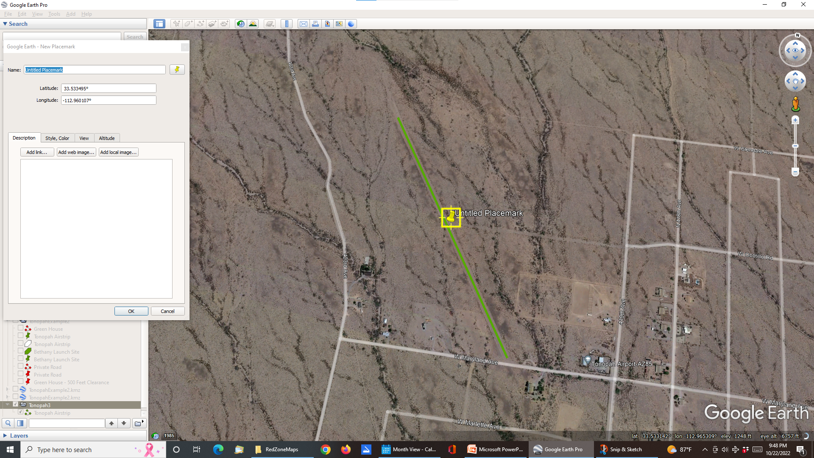
Add Label
Left click to drag and drop push pin closer to the airstrip

Slide 44
Add Label
Left click to drag and drop pushpin closer to the airstrip
Key label into Name box

Slide 45
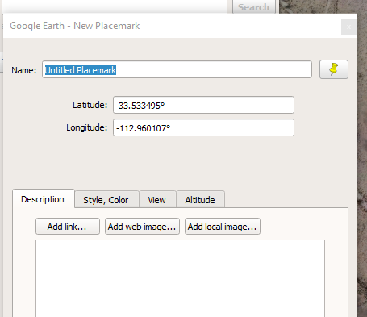
Add Label
I used Tonopah Airstrip

Slide 46
Add Label
I used Tonopah Airstrip
Then click Style, Color tab

Slide 47
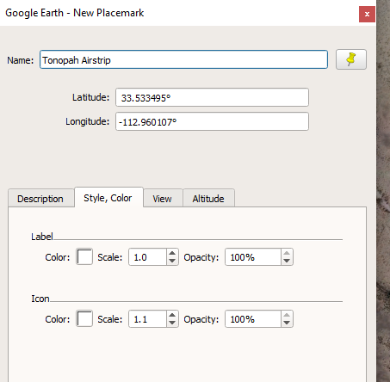
Add Label
Click on Label Color
  I selected green

Slide 48
Add Label
Click on Label Color
  I selected green
Click on Icon Color
  Again I selected green

Slide 49
Add Label
Click on Label Color
  I selected green
Click on Icon Color
  Again I selected green
Then click on OK at bottom of window

Slide 50
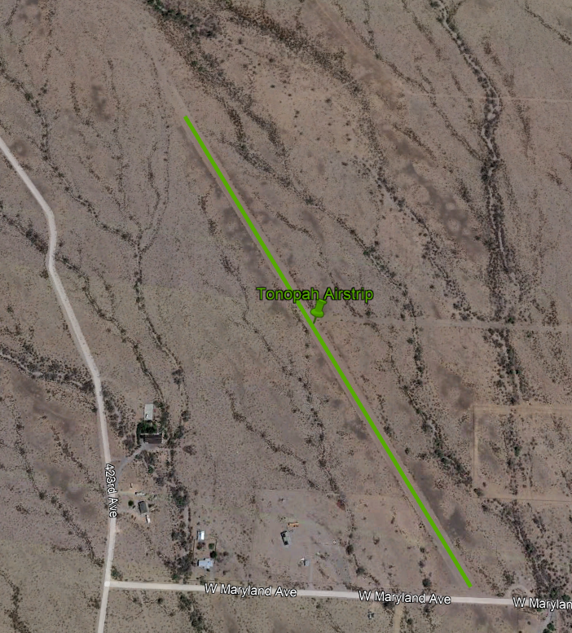
Viola - Straight Line Done

Slide 51
4 - Crooked Line

Slide 52
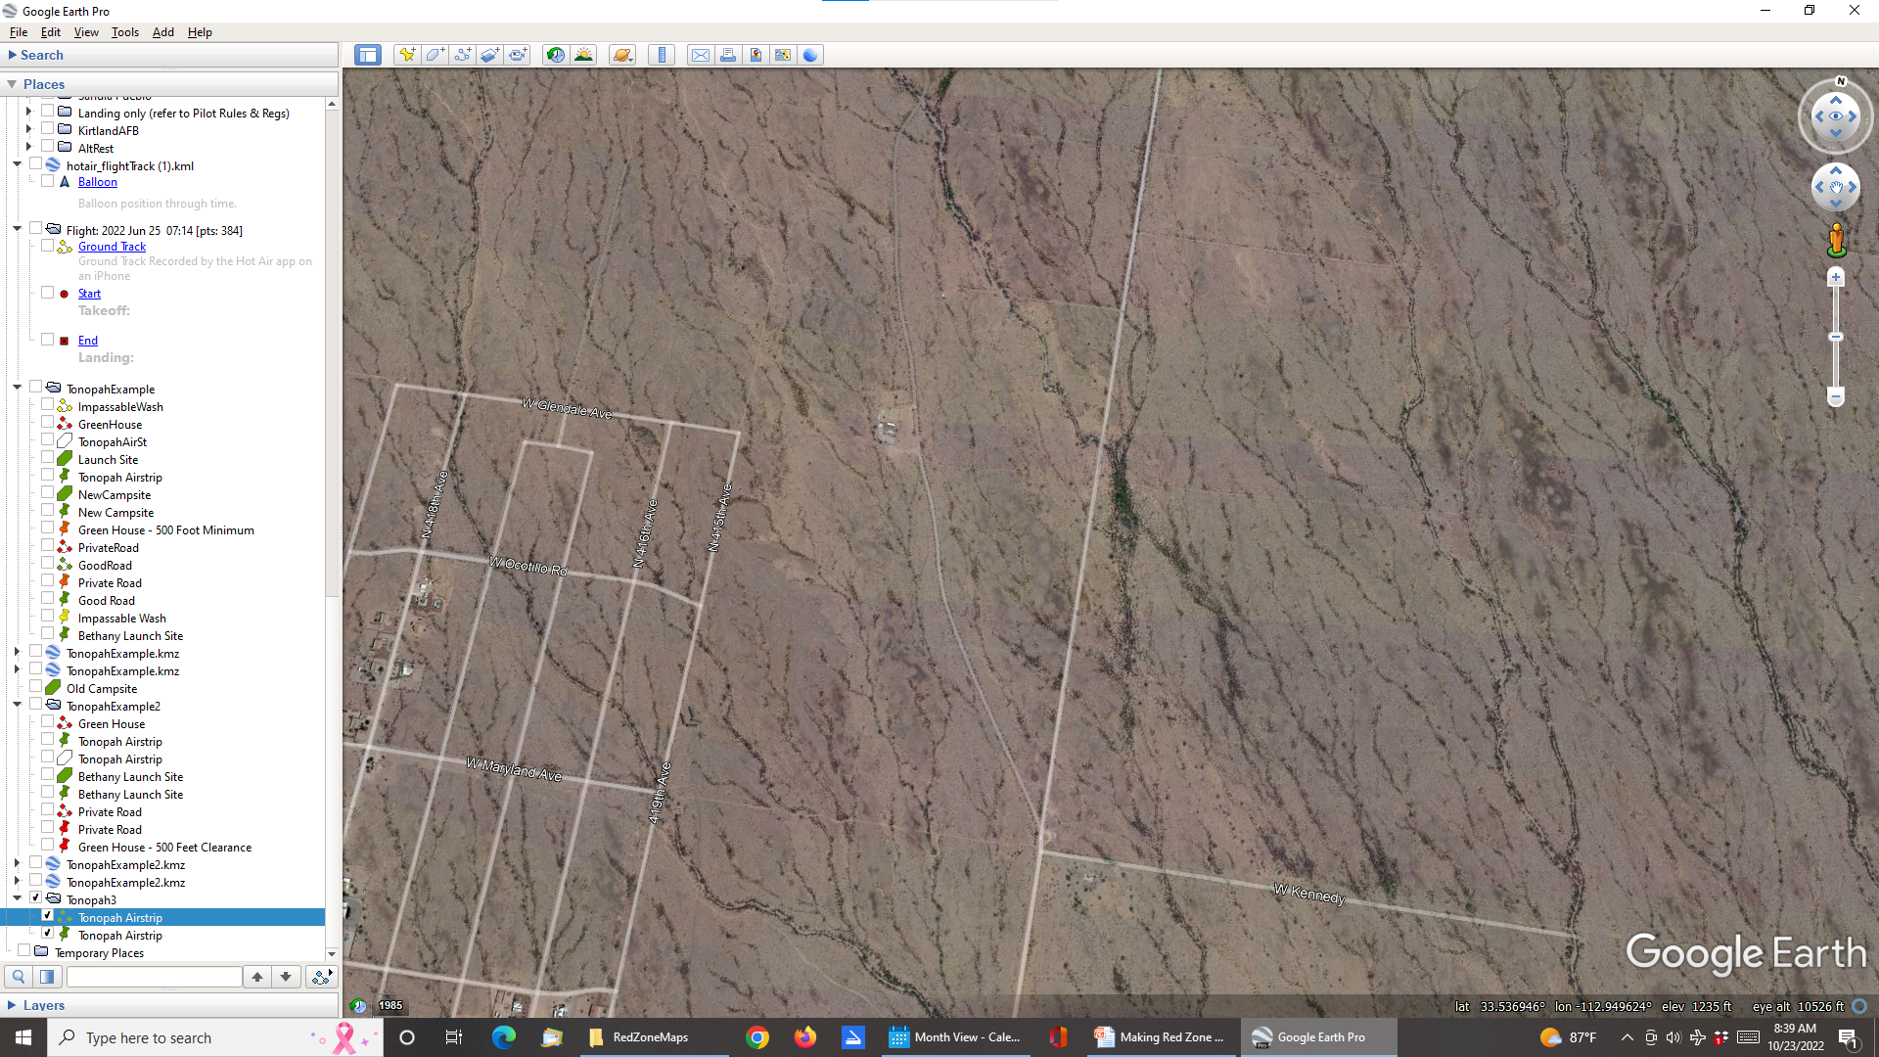
Crooked Line
Same steps as with straight line

Slide 53
Crooked Line
Same steps as with straight line
  except need a dozen or more clicks instead of just two

Slide 54
Crooked Line
Same steps as with straight line
  except need a dozen or more clicks instead of just two
Example - private road we cannot use

Slide 55
Crooked Line
Same steps as with straight line
  except need a dozen or more clicks instead of just two
Example - private road we cannot use
Again click Add Path icon
  Fourth from the left

Slide 56
Crooked Line
Same steps as with straight line
  except need a dozen or more clicks instead of just two
Example - private road we cannot use
Again click Add Path icon
  Fourth from the left
Then drop a breadcrumb at every bend in the road

Slide 57
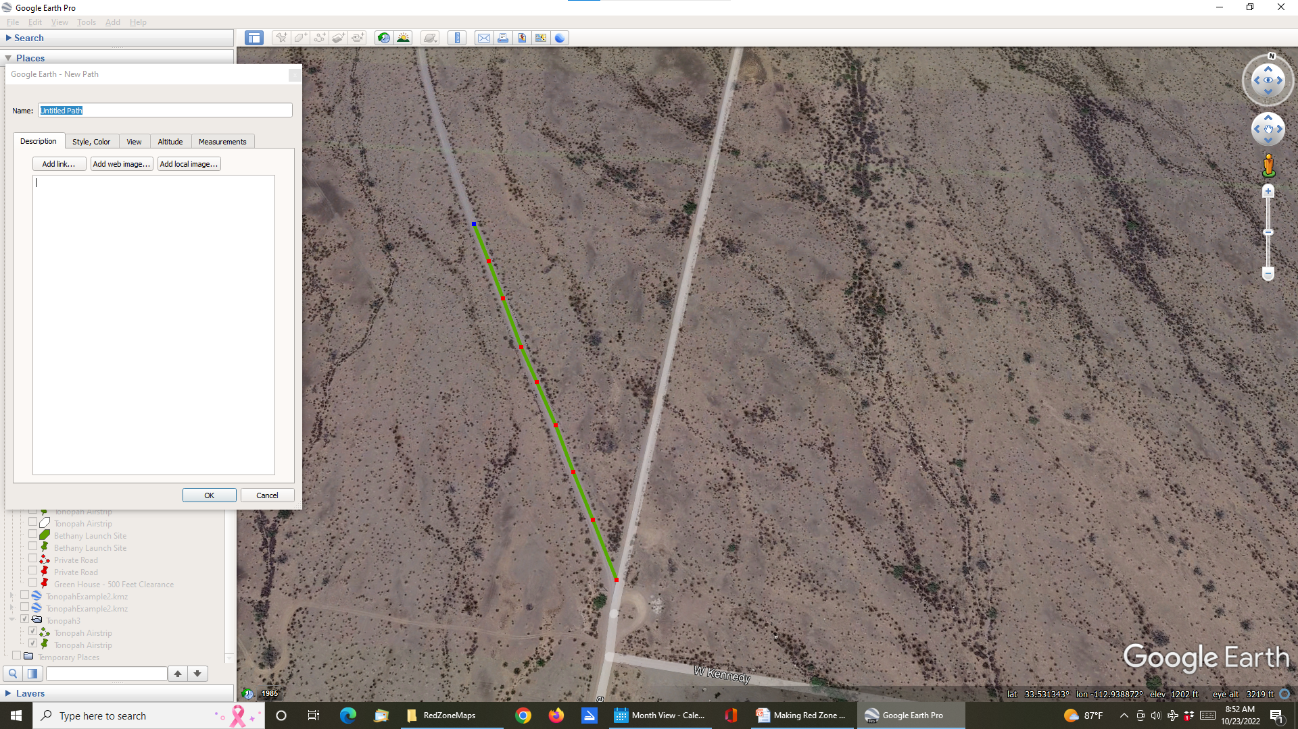
Crooked Line
Hard to see so graphics need to be punched up

Slide 58
Crooked Line
Hard to see so graphics need to be punched up
Label in the Name window

Slide 59
Crooked Line
Hard to see so graphics need to be punched up
Label in the Name window
  I used Private Road

Slide 60
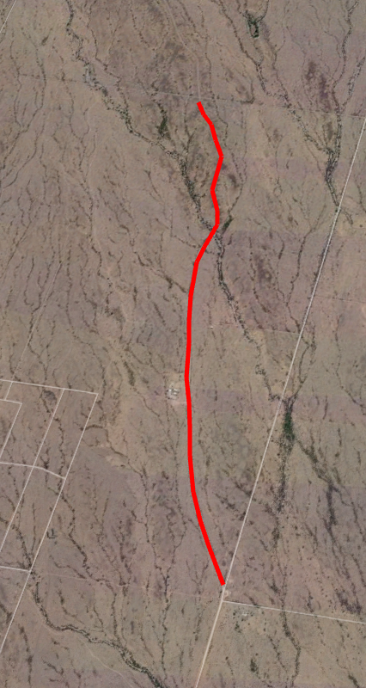
Crooked Line
As with Straight Line select Style, Color tab

Slide 61
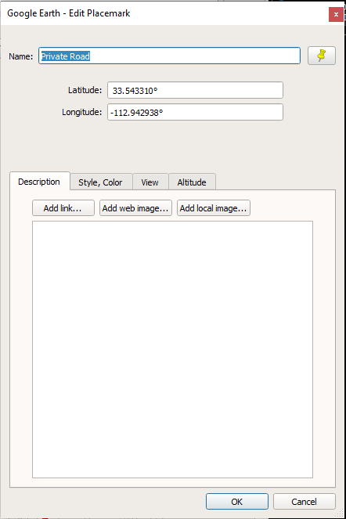
Crooked Line
As with Straight Line select Style, Color tab
Color red
Width 5.0
Click OK

Slide 62
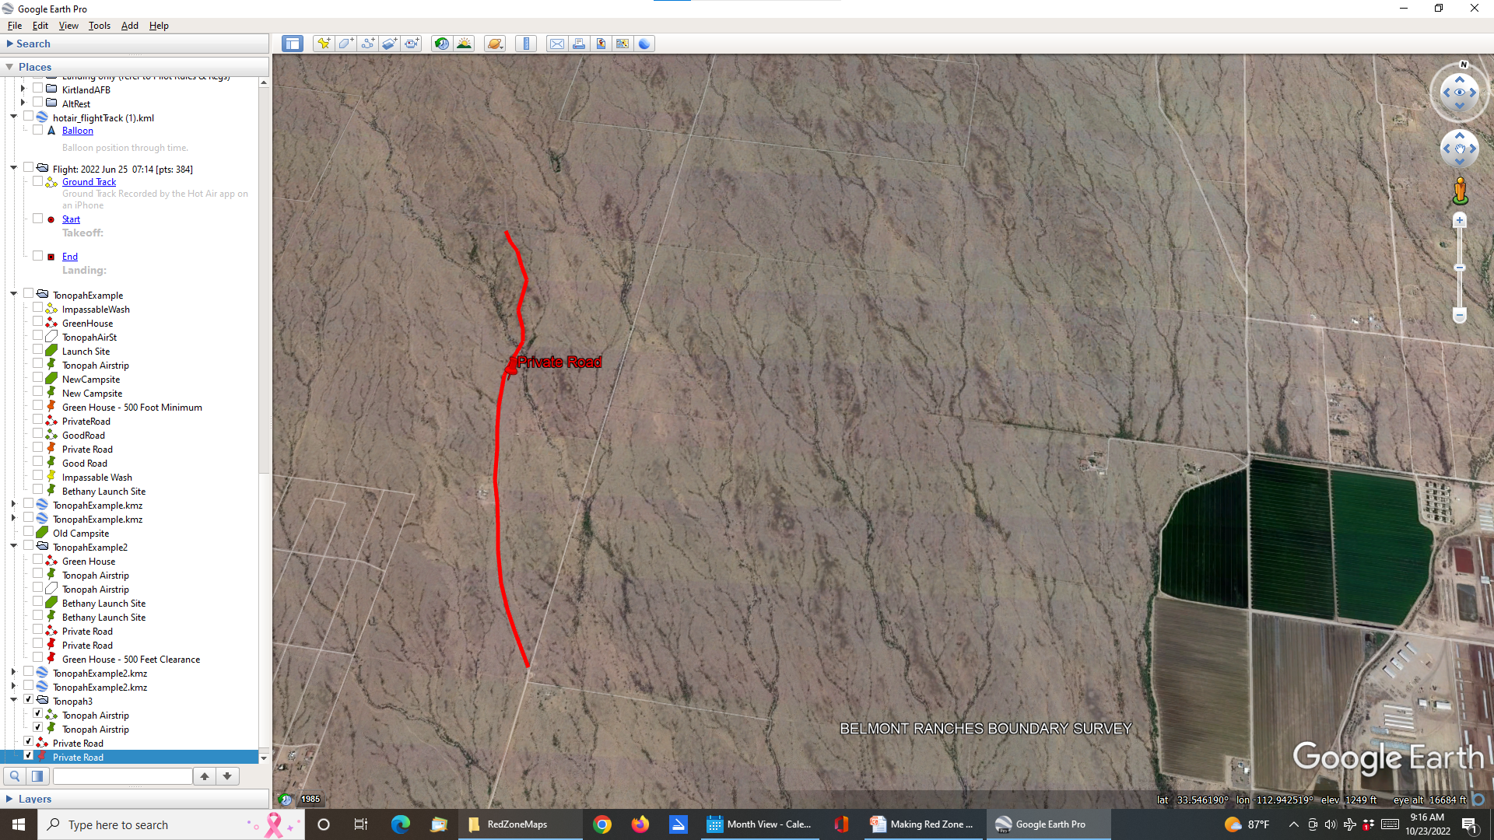
Crooked Line
Same procedure for labeling

Slide 63
Crooked Line
Same procedure for labeling
  Select push pin icon at upper left

Slide 64
Crooked Line
Same procedure for labeling
  Select push pin icon at upper left
  Drag and drop push pin icon near road with left mouse button

Slide 65
Crooked Line
Same procedure for labeling
  Select push pin icon at upper left
  Drag and drop push pin icon near road with left mouse button
  Add label – I used Private Road

Slide 66
Crooked Line
Same procedure for labeling
  Select push pin icon at upper left
  Drag and drop push pin icon near road with left mouse button
  Add label – I used Private Road
  Color, Style
    Red for both icon and label

